Slide 1
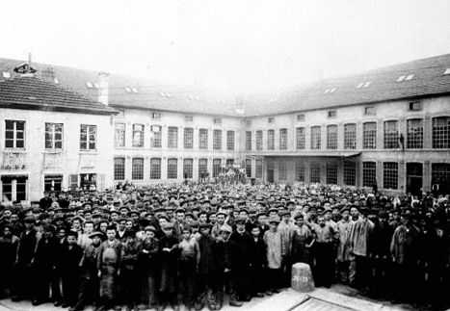
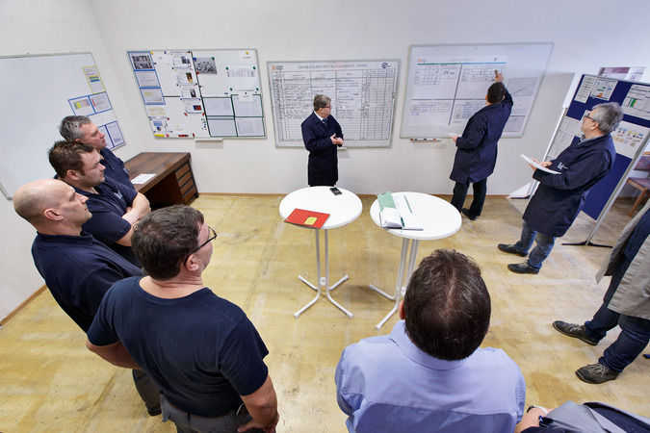
LE GROUPE LISI
NOTRE HISTOIRE
NOTRE VISION
NOS IMPLANTATIONS

Slide 2
NOS CHIFFRES-CLES
LISI GROUP
OUR VISION
OUR HISTORY
OUR LOCATIONS
OUR KEY FIGURES

